Slide 1

Analytical CRM Development for a Bank
Preety Rai
18 September 2024

Slide 2
Agenda
Problem Statement
Data Description
Objective Key Metrics and Visualizations
Subjective Question for Insights

Slide 3
Problem Statement
The Bank is looking for key insights for the following objectives:
Reduce customer churn
Improve service delivery
Enhance customer satisfaction

Slide 4
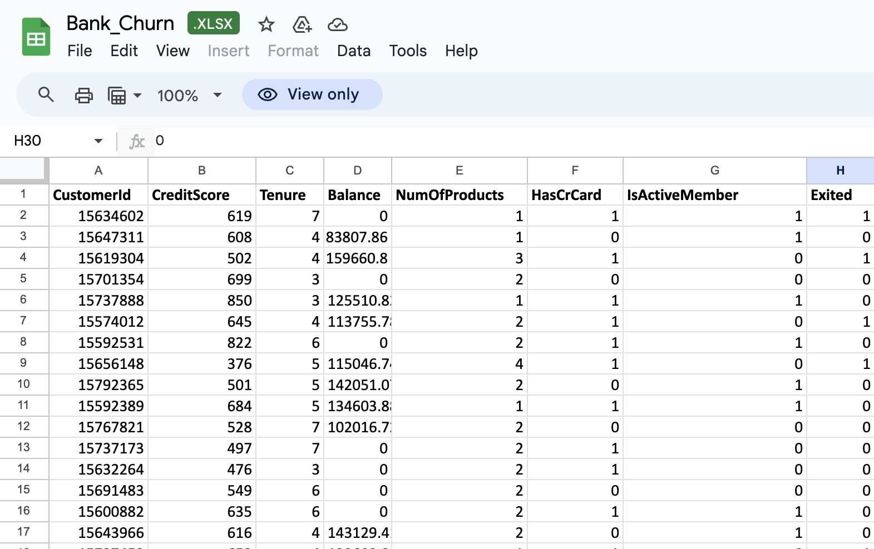

Slide 5
The image above displays the details of banks for bank churn .
1.) CustomerId: Unique identifier for each customer.
2.) CreditScore: Credit score of the customer; higher scores usually indicate more creditworthiness.
3.) Tenure: Number of years the customer has been with the bank.
4.) Balance: The amount in the customer’s account; a 0 balance could mean the customer doesn't have money in their bank account at the time of data collection.

Slide 6
5.) NumOfProducts: Number of products (such as credit cards, loans, etc.) the customer uses.
6.) HasCrCard: Indicates if the customer has a credit card (1 for yes, 0 for no).
7.) IsActiveMember: Indicates if the customer is an active bank member (1 for active, 0 for inactive).
9.) Exited: A binary column where 1 means the customer has left the bank (churned), and 0 means they are still a customer.

Slide 7
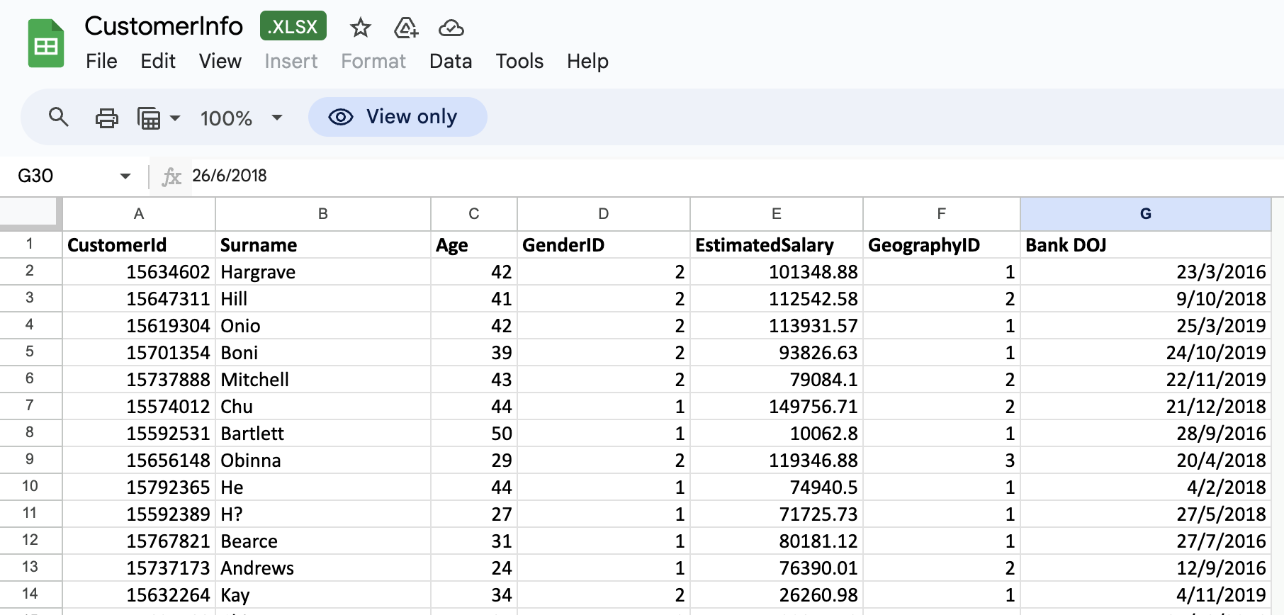

Slide 8
The image above displays the details of banks for customer info.
1.) CustomerId: Unique identifier for each customer.
2.)Surname: Last name of the customer; this may provide no specific analytical value but can be used for identification or sorting purposes.
3.)Age: Customer’s age, which could be useful for analyzing customer demographics and their impact on behaviors like spending, saving, or churn.
4.)GenderID: Encodes gender, with 1 and 2 likely representing male and female, respectively (though confirming the encoding is ideal).

Slide 9
5.)EstimatedSalary: The customer’s annual estimated salary, which can help in analyzing customer segments by income.
6.)GeographyID: Encodes the customer’s geographical location, likely representing different regions or countries (such as 1 = region A, 2 = region B, etc.).
7.) Bank DOJ (Date of Joining): The date when the customer joined the bank. This can be used to calculate tenure with the bank and analyze loyalty or retention based on duration.

Slide 10
Objective
To extract meaningful insights from various customer related datasets . The bank aims to reduce customer churn , improve service delivery and enhance customer satisfaction.

Slide 11
Benefits of CRM in Banking
Improve Customer Retention Rate
Better Segmentation of Customers
Make Workforce More Productive.
Better Insights That Help Campaign Success
Boost Customer Satisfaction
Enhance Marketing Efforts.

Slide 12
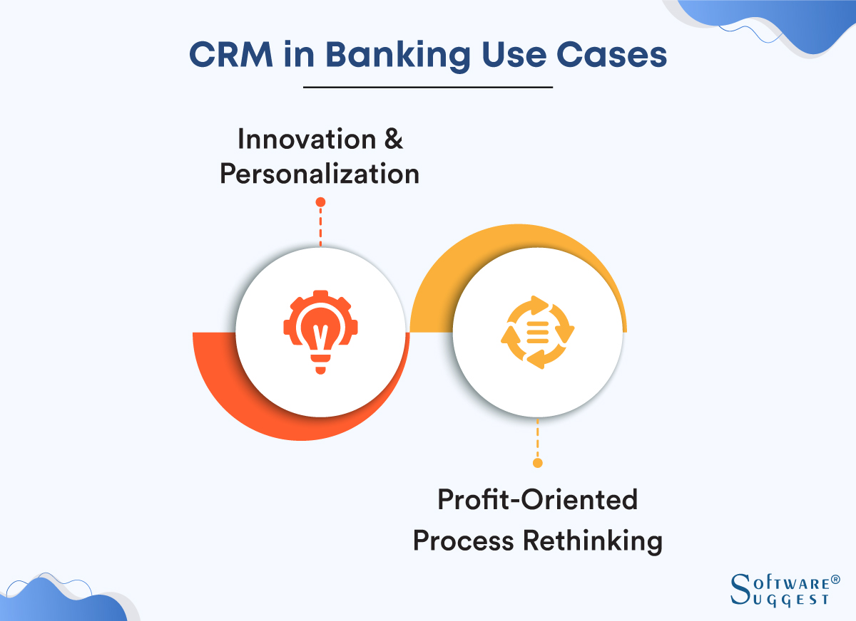

Slide 13
Features to Look in Bank CRM
Analytics :- Provides insights into customer behavior, preferences, and trends to help banks personalize services, improve retention, and drive growth.
Automation :- Streamlines repetitive tasks like data entry, customer communication, and reporting, freeing up time for staff to focus on more valuable interactions.
Mobile Access :- Enables customers and bank employees to access CRM systems on mobile devices for improved flexibility and real-time data on-the-go.

Slide 14
4.)Security Certifications :- Ensures the CRM system adheres to industry security standards (e.g., ISO, PCI-DSS) to protect sensitive customer data.
5.)Lead Management :- Tracks and manages potential customers (leads) through various stages of the sales funnel to convert them into loyal customers.
6.)Compliance:- Ensures the CRM system complies with banking regulations (e.g., GDPR, KYC) to avoid legal risks and ensure proper customer handling.
7.)Data Security:- Implements encryption, access controls, and other measures to protect customer data from unauthorized access or breaches.

Slide 15
Data Overview
Customer data from three different regions are given i.e France Spain and Germany.
In the data bank has largest number of customers coming from France.
From the data we can also see that credit card facility is mostly used by the customers and also helps me customer retention.
Also only one product from the bank is mostly used by customers.
We have also seen that long term customers have quite large amount of money in the form of balance.

Slide 16
Tools and Methodology
Power BI , Sql Workbench
In Sql analysis is performed by using various sql query on different parameters to analyze the data.
In Power BI steps taken in the analysis like data cleaning, data enrichment, and the types of analysis conducted (eg. power query editor, measure etc)

Slide 17
Analysis :-
Bank has largest number of customers coming from France i.e 707 customers.
Female has greater average estimated salary as compared to Male.
Average customer lifetime or tenure of customers revolves around 4.7 to 4.8 years.
Older customers show higher loyalty and lesser churn rates as compared to new customers.

Slide 18
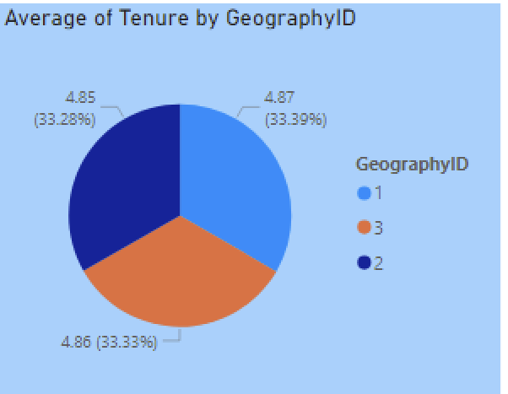
Tenure By Geography ID
From this we can clearly see that average tenure of customers from all the geographical regions are almost same.

Slide 19
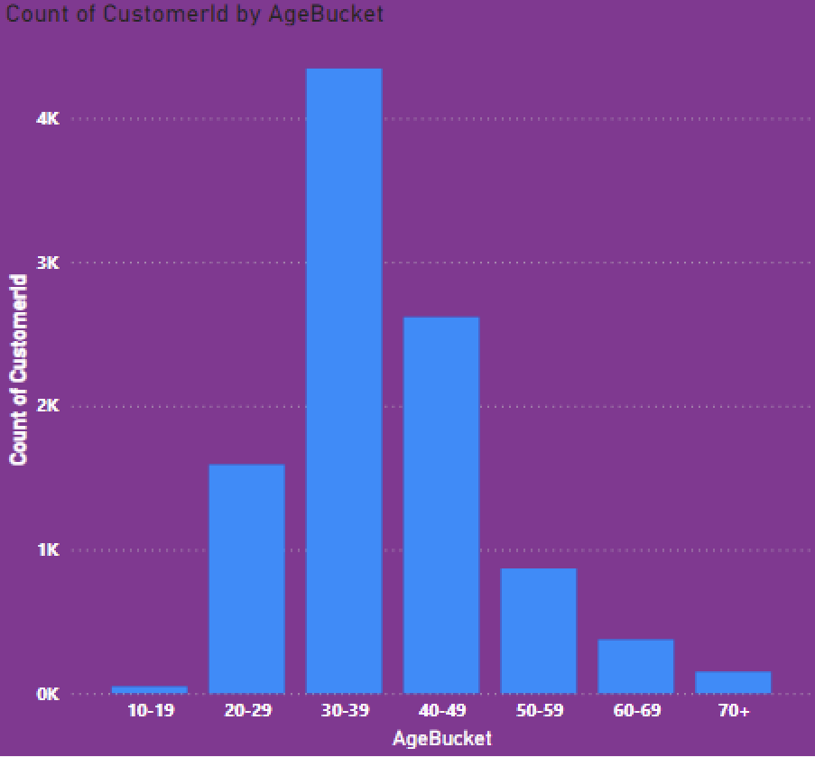
Count of Customers in a particular Age Bucket
This bar chart clearly shows that bank has largest number of customers in the age bucket of 30-39 followed by 40-49 and so on.

Slide 20
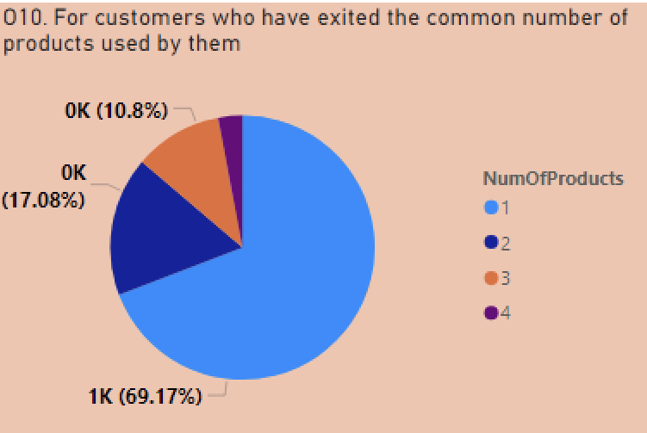
Count of Customers by number of Product they are using
In this we can clearly see that num of products 1 and 2 is mostly used by customers across all the regions.

Slide 21
Insights :-
Customer Gender Distribution:- Maximum number of users from the bank is Male from France i.e 2753 customers.
Credit Card Facility is mostly used by bank as out of 10000 customers 7055 customers are using credit card.
Also we can see that France Pose to have highest financial risk to the bank as compared to Spain or Germany.
From the data we can see that customers who have low credit card score i.e in between 300 and 600 tend to show higher exit rate.
Data also shows that customers in the age bucket of 20-29 has highest number of customers using credit card.

Slide 22
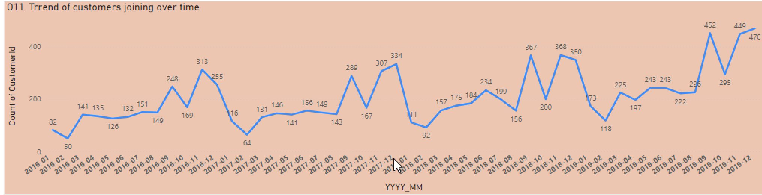
5.) Analysis also shows that customers who have exited were using only 1 products from the bank.
6.) This is how joining trend of customer shows over month and year.
From this we can see that trend follows the zig-zag pattern and overall number of customers is increasing in the bank on yearly basis.

Slide 23
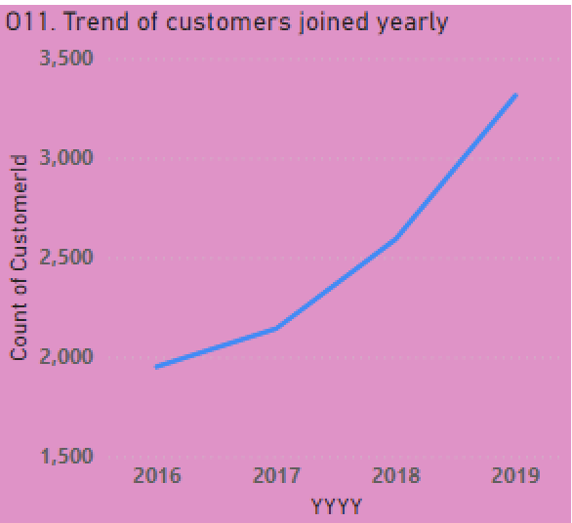
From this we can see that trend of customers joining the bank significantly increases from year 2016 to 2019 i.e 3, 300 customers .

Slide 24
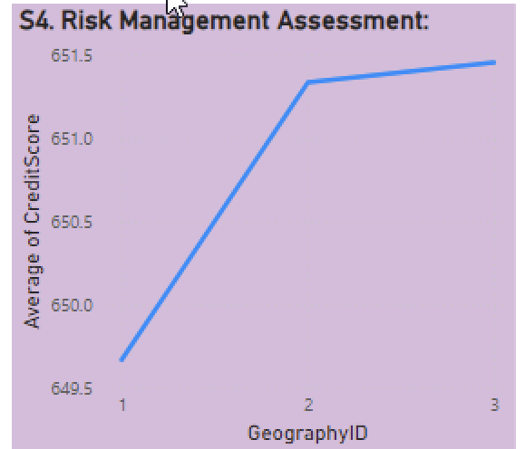
Risk Management
From this we can see that Geography ID 1 poses highest risk to the bank, as the credit score of customers are very low as compared to other regions.

Slide 25
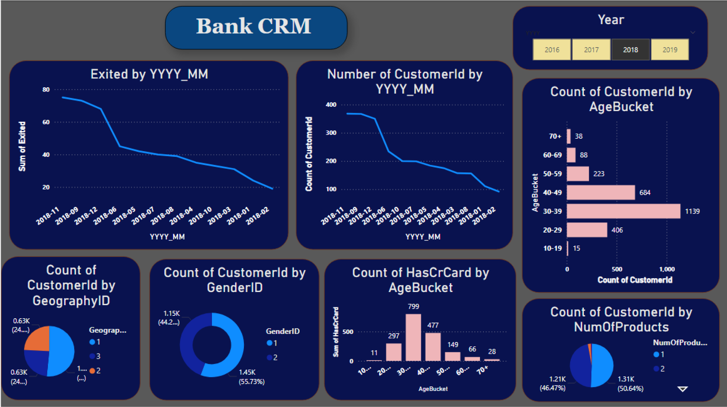

Slide 26
Strategic Recommendations
Customer Segmentation
Enhanced Customer Support
Customer Loyalty Program
Data Driven Insights
Personalized Customer Experience
Integration of CRM with Core Banking Systems.
Compliance and Data Security
Performance Monitoring And Feed back.

Slide 27
Conclusion
From this data we can see that trend of customers joining the bank significantly increases from year 2016 to 2019 that shows a very good growth in bank.
Around 69.7 % of customers only use 1 product from the bank .
Bank has largest number of customers in the age range of 30-39 years.
Geography ID 1 poses highest risk to the bank.

Slide 28


